Slide 1
Search Engine Optimization

Slide 2
What is SEO ?
01. Get top position
02. Get visitor

Slide 3
Source Of income through SEO
01. Freelancing
02.Blogging / adsense
03.Affiliate marketing
04. Rent a space ,
Domain business etc.

Slide 4
Freelancing
01. odesk
02.freelancer
03.Elance

Slide 5
Blogging and Adsense
01.Get pay per click
02.Monthly income
$100 - 10,000

Slide 6
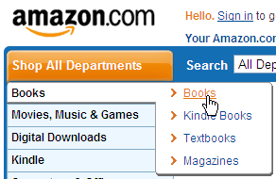
Affiliate marketing
01.Sell affiliate products
&
Get revenue
02 .Montly income
$100 - 10,000

Slide 7
Domain business & rent a space
01. Domain business
02. Rent a web space

Slide 8
Requirements of learning SEO
01. Basic web development knowledge
02.Own website
03.Good english skill
04. Cpanel knowledge

Slide 9
Types of SEO

Slide 10
On page optimization
01.Target keyword
https://adwords.google.com/o/KeywordTool
02. Meta tags optimization
03. unique content
04. Sitemap map creation and submission
05. 301 and 302 redirect

Slide 11
Off page Optimization
01.Social bookmarking
02.Directory submission
03.Forum posting
04.Article submission
05. Link wheel

Slide 12
Freelancing job
01. Forum posting
02. Directory submission
03. Social bookmarking
04. Link wheel
&
Full site seo

